Slide 1
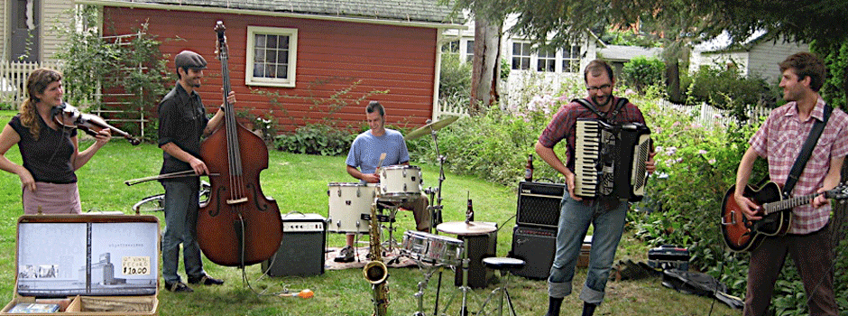
Mobility-as-a-Service (MaaS)
A Concept for Small Urban & Rural America
As imagined in Tompkins County / Ithaca, New York
UbiGo Pilot
Dwight Mengel, Feb 27, 2017

Slide 2
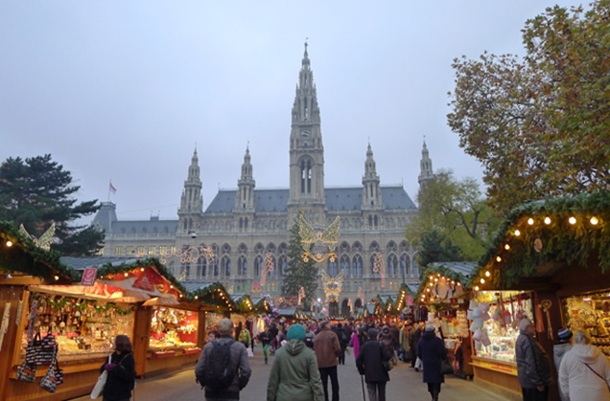
Vienna, Austria – Smile App
The project SMILE - "Smart Mobility Info & Ticketing System Leading the Way for Effective E-Mobility Services" - has won a UITP Award in the customer experience category.
UITP (International Association of Public Transport)
The future of mobility …
Within the project smile the key for the mobility of the future was developed: the prototype of an integrated mobility platform with a smartphone app.
https://youtu.be/Yd4_L-FG8Cg
https://youtu.be/Yd4_L-FG8Cg

Slide 3
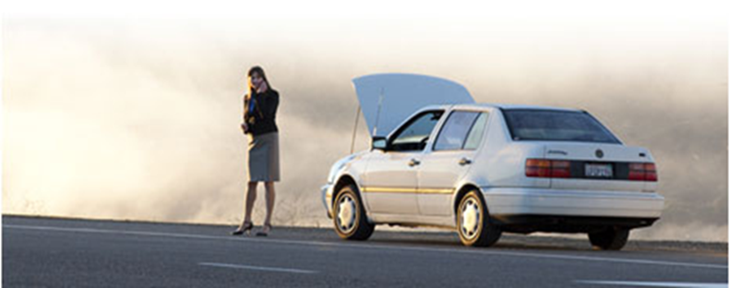
Ithaca – MaaS as Customer Service Integrator
“… shift from selling features & benefits to building relationships with consumers…”

Slide 4
Mobility-as-a-Service is a consumer service that:
Educates people about local community mobility services.
Sells mobility services to people on a pay-as-you-go basis or an annual plan (similar to budget-billing provided by NYSEG).
Provides a guaranteed ride program when there are trip failures.

Slide 5
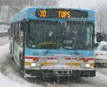
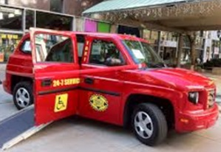
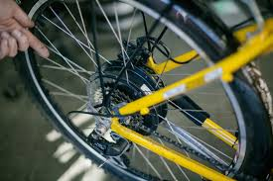
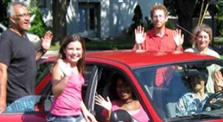
Mobility Services Menu | Price | Unit
Annual Adult Bus Pass | $ 450 | Annual
Annual Youth Bus Pass | $ 110 | Annual
Ithaca Carshare "Its my car" Plan | $ 8 | Trip
Ithaca Carshare "Just in Case" Plan | $ 11 | Trip
Car Rental | $ 55 | Day
Taxi trip - City | $ 8 | Urban Trip
Taxi trip - Rural | $ 20 | Rural Trip
Bicycle Maintenance | $ 50 | Voucher
Electric Bike Purchase | $ 2,500 | HE Bike
Bike Purchase | $ 700 | Bike
Rideshare Driver – Miles | $ 0.54 | Mile
Rideshare Rider – Miles | $ 0.15 | Mile
GADABOUT Paratransit | $ 4 | Trip
Vanpool Membership | $ 125 | Month/Seat
Guaranteed Ride | $ 30 | Annual

Slide 6
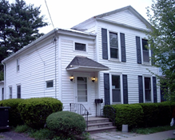
Small City Household 1 car, 2 adults, 1 youth, Walkscore = 96
Small City Mobility Budget
Carshare | $ 900
Annual Bus Passes (2) | $ 560
Taxi | $ 192
Bicycle Maintenance | $ 100
Guaranteed Ride | $ 30
Member Support | $ 178
Annual Total | $ 1,960
Monthly Payment | $ 163

Slide 7
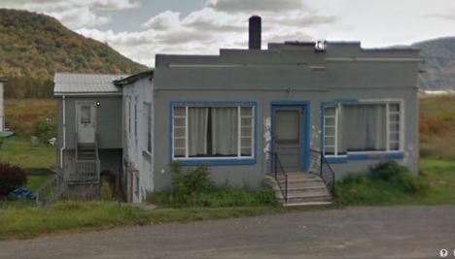
Rural Household 1 car, 2 adults, 1 child, Walkscore = 0
Rural Mobility Budget
Vanpool | $ 1,500
Carshare | $ 480
Taxi | $ 480
Guaranteed Ride | $ 30
Member Support | $ 146
Volunteer Driver Revenue | $ (400)
Vanpool Program Subsidy | $ (600)
Total | $ 1,636
Monthly Payment | $ 136
Notes:
Rural household. Walkscore =0. No bus service.

Slide 8
Retail Model Summary
Member-based Organization
Individual Mobility Plans
Sales & Financing
Aggregate Demand
Process payments to service providers
Concierge Service 24/7 & Guaranteed Ride
Business Co-Marketing & Discounts
Capacity for adaption to future changes
Tools
Inbound Marketing
Apps

Slide 10
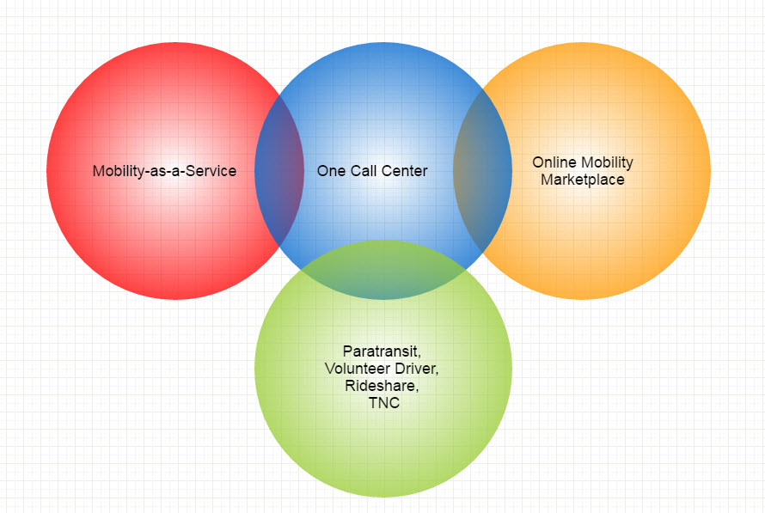
Mobility Coordination Center Concept

