Slide 1
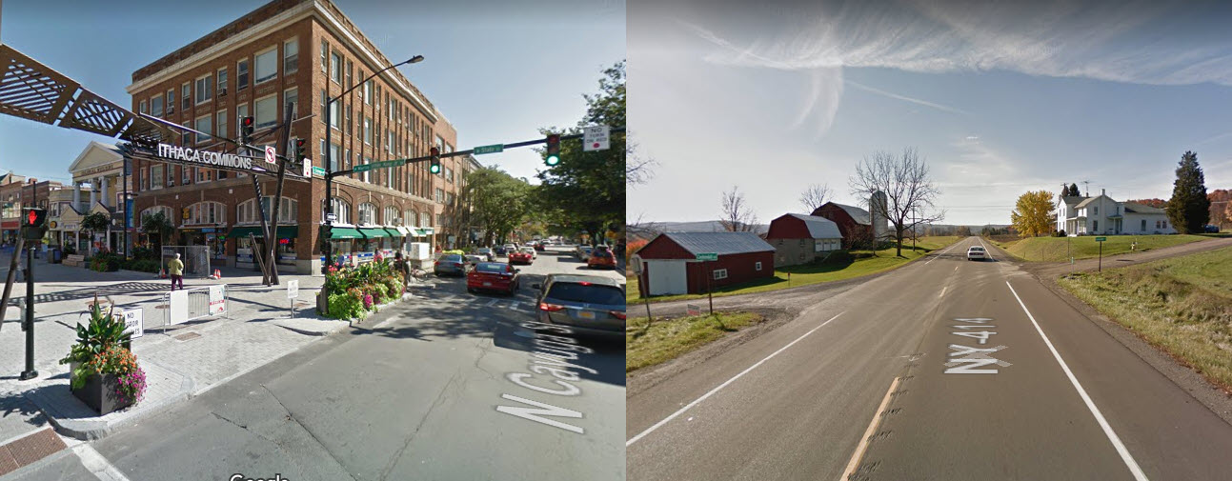
Developing Mobility-as-a-Service
Serving Small Urban & Rural Communities
Tompkins County, NY
Meeting with the Japan Research Institute, Dec 4, 2019
Notes:
104 population. Regional economic growth center based on Higher Education, Manufacturing & Hi Tech, Tourism, Health Care & Agriculture

Slide 2
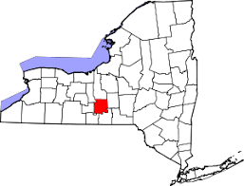
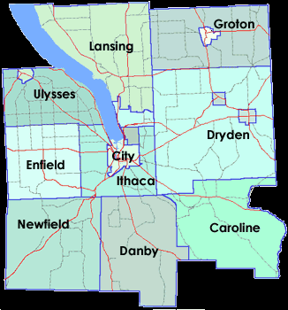
Tompkins County, New York Facts
102,500 Population Ithaca Urban Area pop.54% Rural population 46%
15,000 in-bound commuters daily (20% of workforce)
5,000 outbound commuters.
Economy: Higher Education, Manufacturing, Agriculture, Wine, Tourism, Technology, Services
Regional Growth Center, often has the lowest unemployment rate in NYS.

Slide 3
Value Propositions
MaaS
Financial Services
Customer Services
Innovation
Member Organization
Mobility Information

Slide 4
Value Propositions
Mobility Information & Sales
Education, Marketing, Sales, Annual Mobility Plans
Financial Services
Annual Mobility Plans/Budgets
Monthly Budget Billing or Single Payments
Third-party Fare Payment with mobility operators
Reinvent how Public agencies purchase travel for clients
Credit volunteer driver mileage revenue & employer subsidies
Customer Services
Multi-modal Customer Information
Guaranteed Ride Program
Feedback to Mobility Operators
Business Co-Marketing & Customer Discounts
Innovation
Increase mobility services, especially Rural.
Incorporate future mobility services

Slide 5
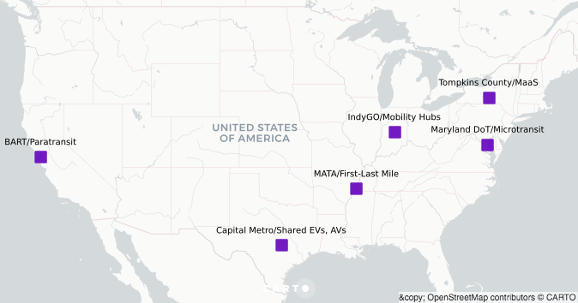
From June 2018-Nov 2019, Tompkins County participated in the FTA’s Mobility-on-Demand On-Ramp Program to rework its MaaS concept into a multi-phase project.
Notes:
The On-Ramp program provides technical assistance through the Shared Use Mobility Center of Chicago to create a business model for a Maas pilot project.

Slide 6
MaaS Phase 1
Building Blocks
Multi-Modal Customer Service
Rural Mobility Services
Multi-Modal Trip Planning

Slide 7
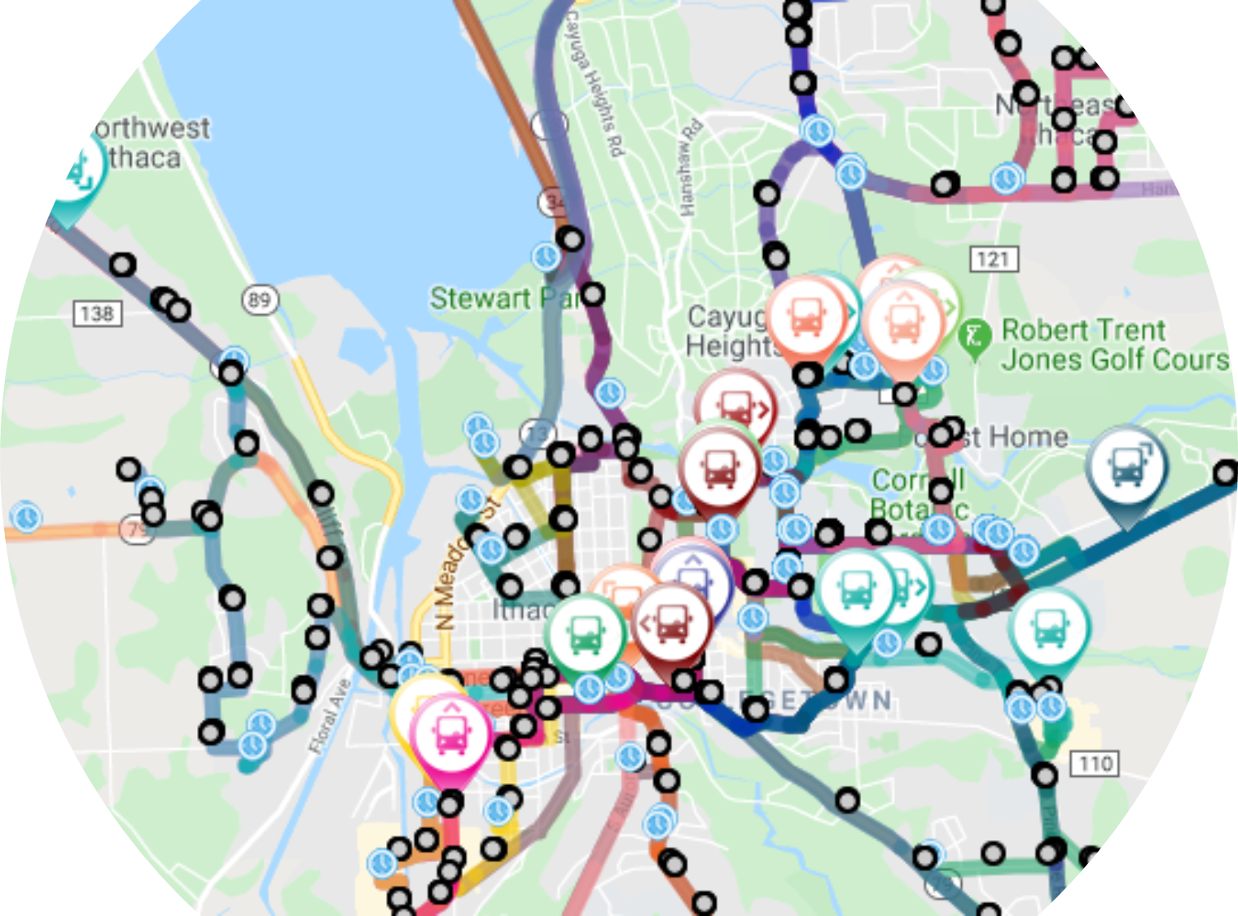
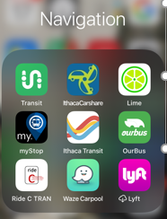
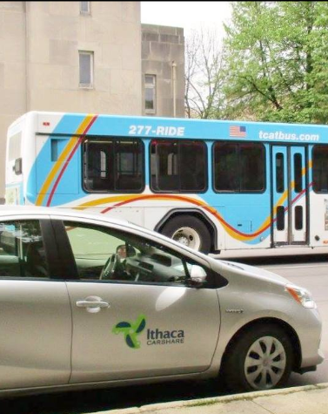
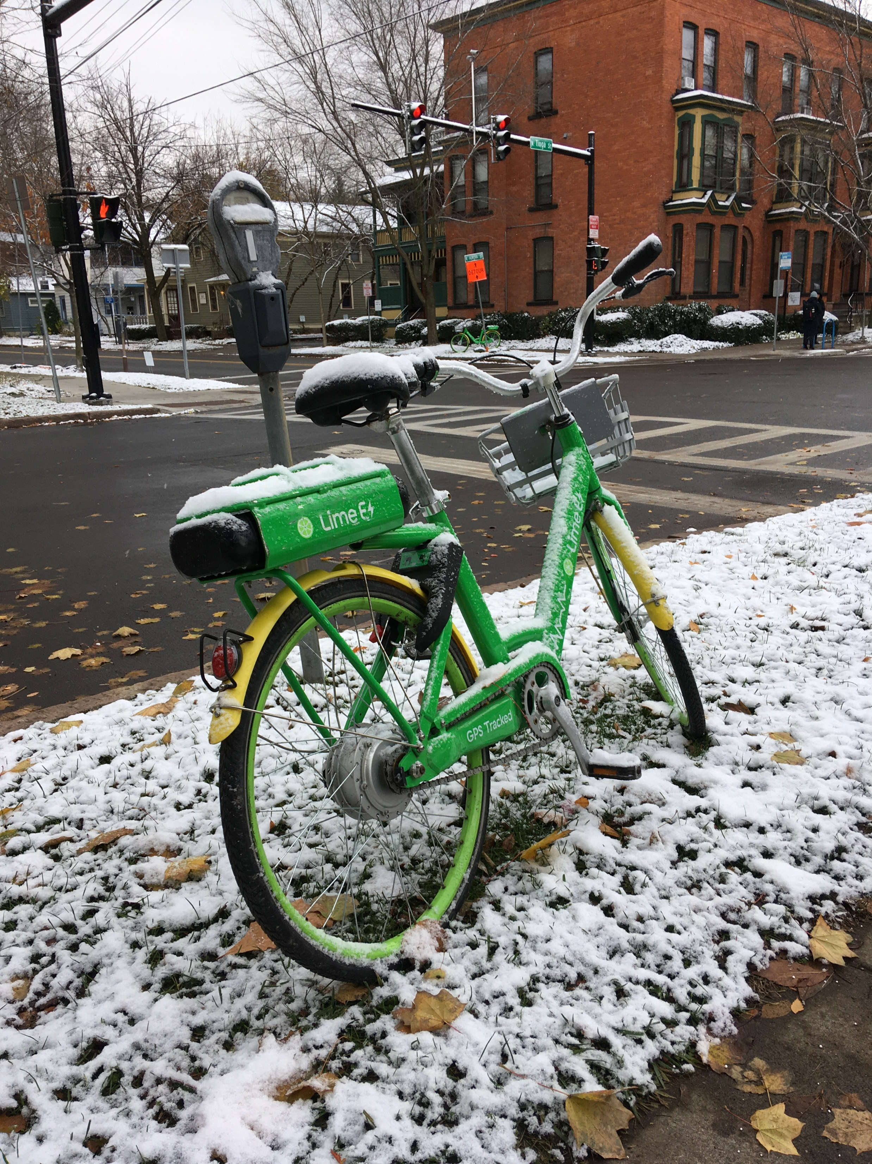
Multi-Modal Trip Planning
Intercounty Bus Services
Bus routes from three counties connect with TCAT.
Shared-Use Services
Ithaca Carshare
Lime
Taxi
TNC’s (Lyft & Uber)
Paratransit (Gadabout)

Slide 8
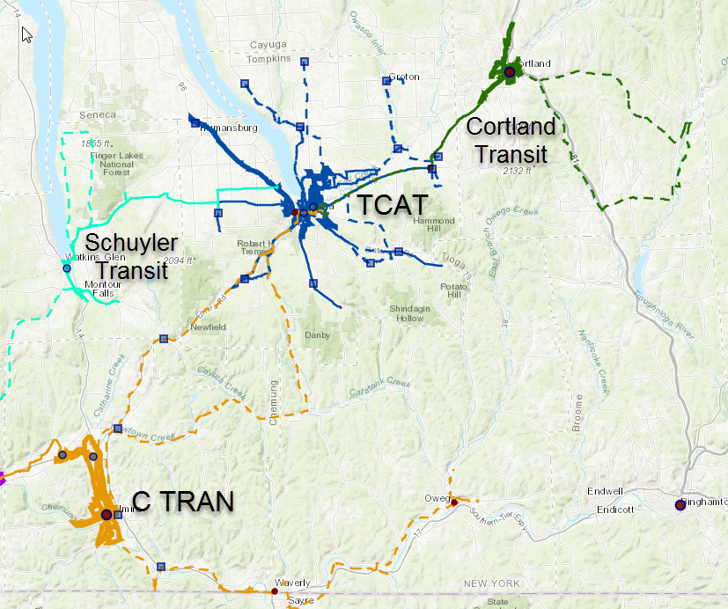
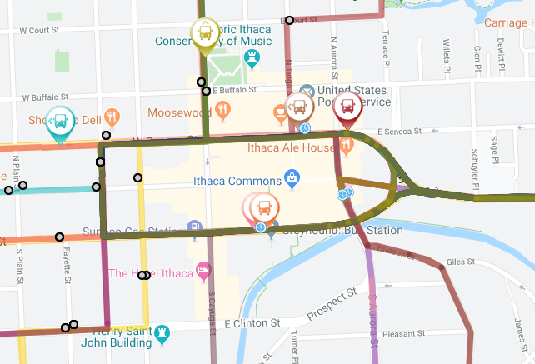
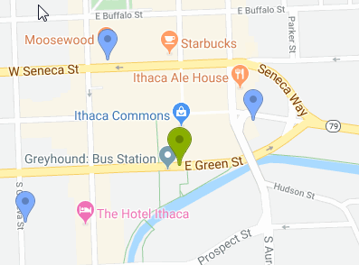
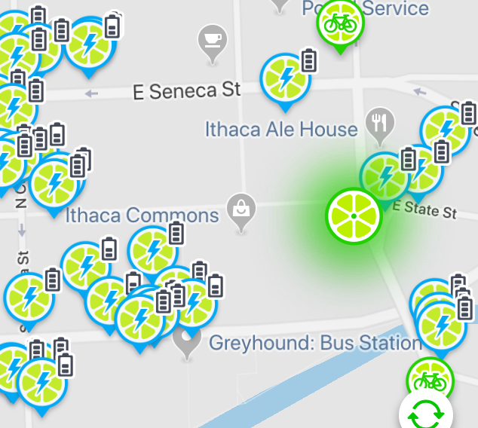
Inter-County Commuter Bus
TCAT system
Ithaca Carshare
Lime bikes
Three transit systems Connect with TCAT.
C TRAN & Cortland Transit go to Downtown Ithaca and Cornell Univ. campus.
Schuyler Transit connects with TCAT at the Cayuga Medical Center (hospital).
Only TCAT & C TRAN have real time bus locations via apps.

Slide 9
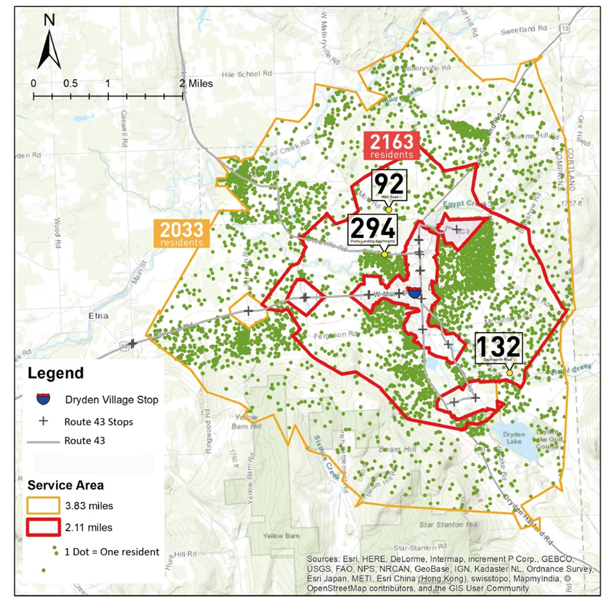
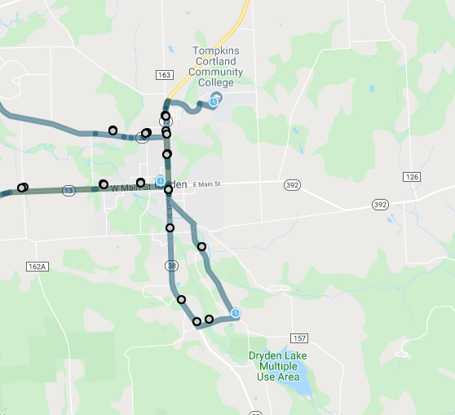
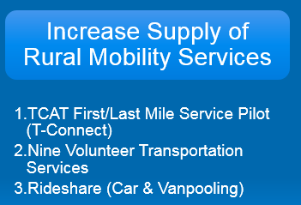
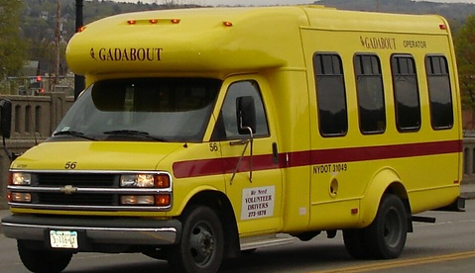
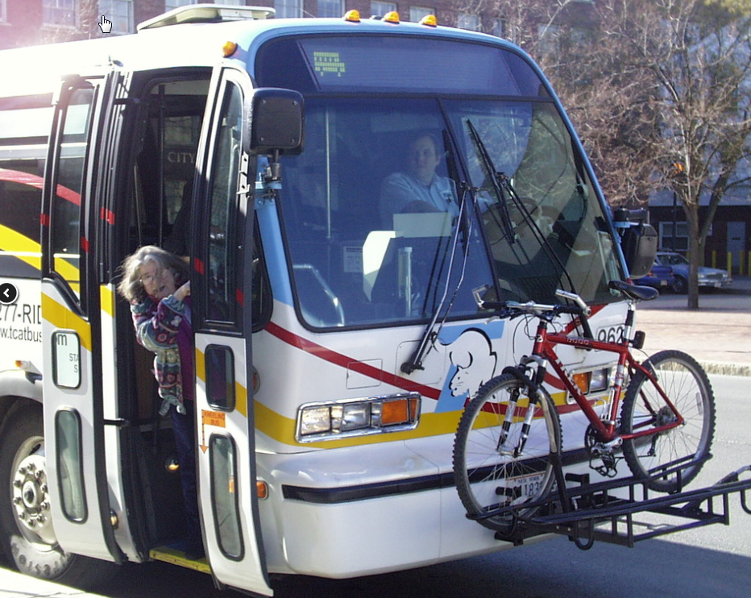
First Mile/Last Mile Pilot 2019-2022
TCAT will design and pilot an app-based FM/LM service that will allow riders using the Urban Mobility app, Hyper-Commute, to schedule a trip on existing paratransit Gadabout minibuses from their residence in rural areas and outlying villages and transfer seamlessly to existing TCAT transit routes. Upon submission of a trip request, the Hyper-Commute software will determine if FM/LM service is available within the time and destination parameters submitted and will display the closest matching trips.
The Way2Go Program of Cornell Cooperative Extension of Tompkins County will provide public outreach, surveys and rider education for the pilot.

Slide 10
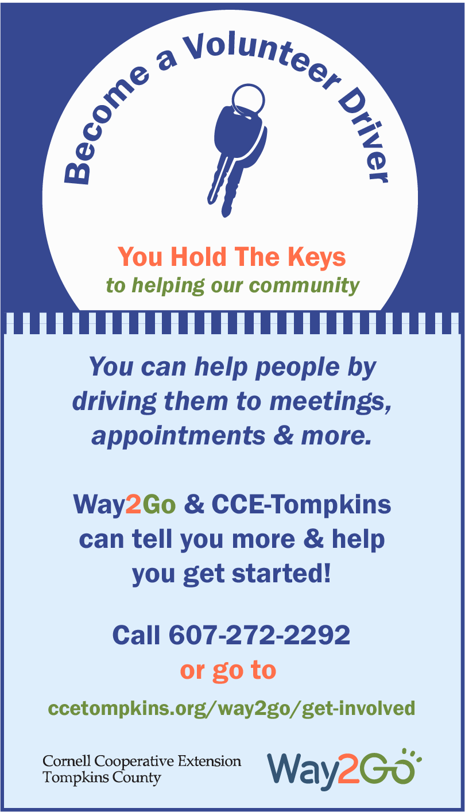
Increase Supply of Rural Mobility Services
TCAT First/Last Mile Service Pilot (T-Connect)
Nine Volunteer Transportation Services
Rideshare (Carpooling)

Slide 11
Multi-Modal 24/7 Customer Service
Information & 24/7 Customer Service Center
Ithaca Carshare & 211 Information & Referral
Enhanced Guaranteed Ride Membership
Way2Go Mobility Education
Watch Way2Go Videos:
Five Fabulous Ways
Aging, Driving and Family Conversations
Ithaca Carshare Basics
Taxi Basics
TCAT Bus Basics
TCAT Bus Basics for Wheel Chair Users
Transit App Tools
Using the Bus Bicycle Rack
Wheelchair Users You've Got Options
Why and how to share more rides
Way2Go Resources and Videos are available in Spanish and Chinese.
Recursos en español
中文资源

Slide 12
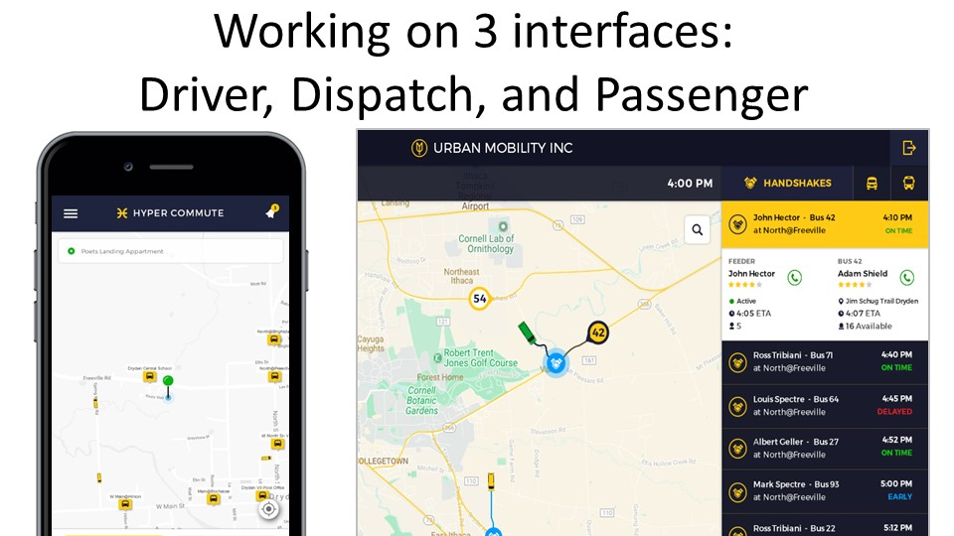
Smartphone Apps
TCAT First/Last Mile Service Operations
Multi-Modal Trip Planning + Customer Services

Slide 13
Multi-Modal Trip Planning App
Integrate travel information from mobility providers and to access customer service through app and web platforms.
Use GTFS and real-time data for TCAT and C-TRAN, GTFS data for two inter-county bus services, GTFS-Flex for Gadabout demand-response service, and the GBFS data for Lime and Ithaca carshare vehicles.
The app and web platforms would include all mobility providers’ and customer service phone numbers programmed for one push to call.

Slide 14
MaaS Phase 2
Customer Service
Member Organization
Financial Services
Innovation

Slide 15
Family of Mobility Services
Notes:
25 services

Slide 16
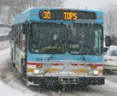
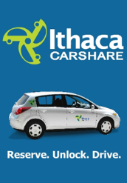
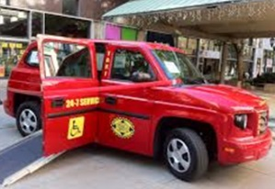
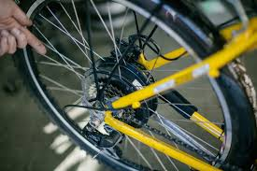
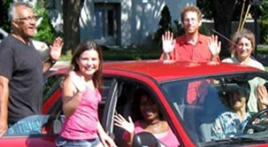
Mobility Menu | Unit Cost | Unit
Annual Adult Bus Pass | $ 450 | Annual
Annual Youth Bus Pass | $ 110 | Annual
Ithaca Carshare "Its my car" Plan | $ 8 | Hour
Ithaca Carshare "Just in Case" Plan | $ 11 | Hour
Car Rental | $ 55 | Day
Taxi trip - City | $ 8 | Urban Trip
Taxi trip - Rural | $ 20 | Rural Trip
Bicycle Maintenance | $ 50 | Voucher
Electric Bike Purchase | $ 2,000 | HE Bike
Bike Purchase | $ 700 | Bike
Rideshare Driver – Miles | $ 0.54 | Mile
Rideshare Rider – Miles | $ 0.15 | Mile
GADABOUT Paratransit | $ 4 | Trip
Vanpool Membership | $ 125 | Month/Seat
Guaranteed Ride | $ 30 | Annual

Slide 17
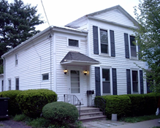
Small City Household 1 car, 2 adults, 1 youth, Walkscore = 96
Small City Family Mobility Budget
Carshare | $ 900
Annual Bus Passes (2) | $ 560
Taxi | $ 192
Bicycle Maintenance | $ 100
Guaranteed Ride | $ 30
Member Support | $ 178
Annual Total | $ 1,960
Monthly Payment | $ 163

Slide 18
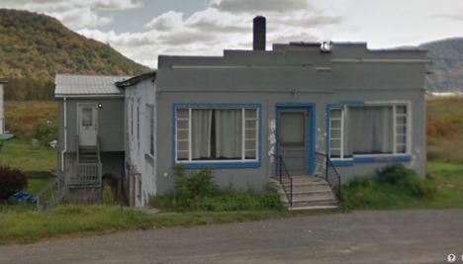
Rural Household 1 car, 2 adults, 1 child, Walkscore = 0
Rural Family Mobility Budget
Vanpool Membership | $ 1,500
Carshare (Discount Plan) | $ 480
Taxi | $ 200
Guaranteed Ride | $ 30
Member Support | $ 121
Volunteer Driver Revenue | $ (400)
Vanpool Program Subsidy | $ (600)
Total | $ 1,331
Monthly Payment | $ 111
Notes:
Rural household. Walkscore =0. No bus service.
Volunteer driver revenue works out to 37 one-trips per year.

Slide 19
Business Development Elements
MaaS Organization
Data Management & Security
Business Planning
Procedures & Policies
Mobility Sales & Budget Billing
Mobility Payment Methods
Process payments to service providers
Public Sector transactions, orders & payments
Member recruitment and customer service
Trip Management, Referral & Fulfillment
Marketing, Business Co-Marketing & Discounts
Technology Strategy – Smartphone Apps + real-time vehicle information + customer notifications
Continuous improvement of mobility services

Slide 20
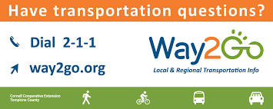
Dwight Mengel, Chief Transportation Planner,
Tompkins County Dept of Social Services, Ithaca, NY
(607) 274-5605 / dwight.mengel@dfa.state.ny.us
Wenzheng Li, PhD student, Department of City & Regional Planning, Cornell University, Ithaca, NY
(607) 262-6270 / wl563@cornell.edu

